Slide 1
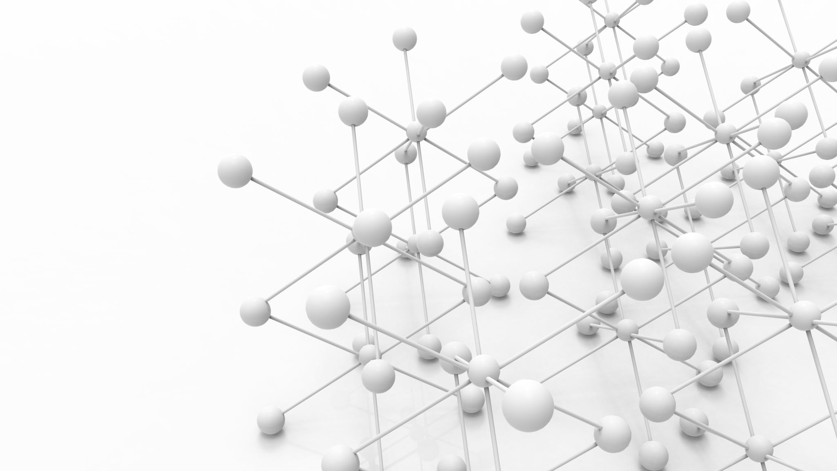
Advisor : Prof. Linwei Wang Student : Saloni Aggarwal
Learning Diffeomorphism-based Data Augmentation

Slide 2
Motivation
For building efficient Deep Neural Network (DNN) lot of labelled data is necessary.
In real life applications this is not always possible.
Data Augmentation is one of the technique to handle this problem where new samples are created and added in existing dataset.

Slide 3
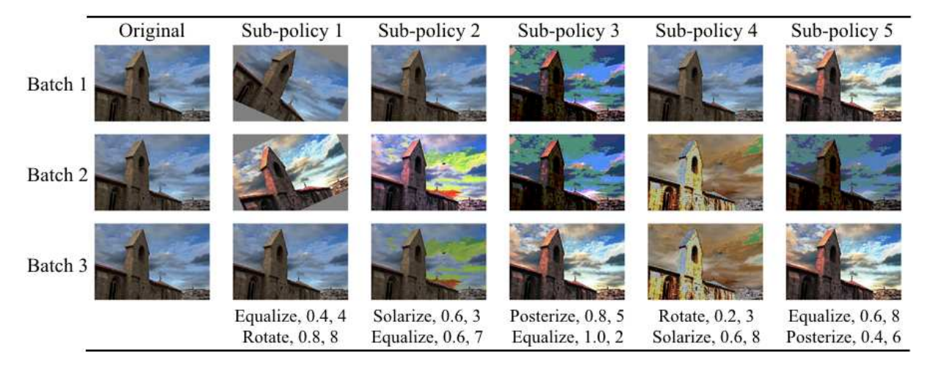
Prior Work
Previously designed state-of-the-art reduces the efforts of selecting best operations and parameters for a given task and dataset. But these transformations are limited to operations like rotation, scaling, translations, etc.

Slide 4
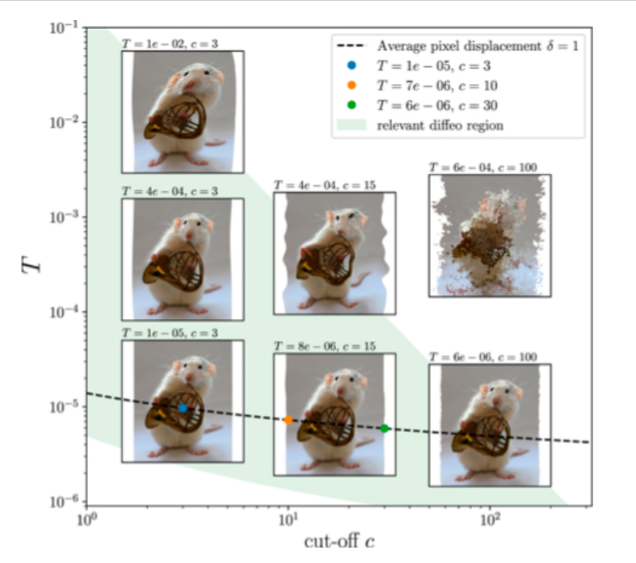
Prior Work
Some other papers have designed global transformation by learning more expressive augmentations. This method allow modelling object's shape variations which is important for image segmentation task.

Slide 5
What's wrong?
These methods assume perfect alignment of the sample pairs provided as input.
This assumption is restrictive and cannot be fulfilled in some scenarios like aligning objects like tumors which can appear in any location.

Slide 6
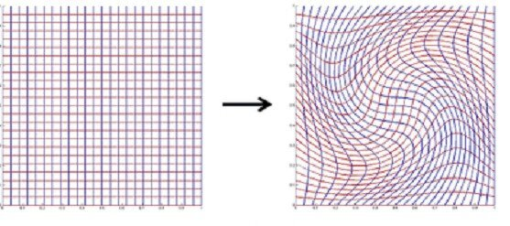
Overview
Propose an object-centric augmentation method.
This will be achieved by transforming object of interest using variations in different instances of the object called diffeomorphism.

Slide 7
Overview
Also explore the idea of learning variations from one dataset and then augment on another dataset. Eg: Liver and Kidney tumors.
Modelling variations in Liver tumor improves the performance for kidney tumor segmentation.

Slide 8
Conclusion
In this project my aim is to build a data-augmentation system for kidney tumor images using diffeomorphism.

Slide 9
Thank You

